Slide 1
Google Play Store’s Insight
Subject Code: DATA 230 Subject Name: Data Visualization
Group 8:
Aruna Jithesh
Chinmayi Karumuri
Karthik Shetty Nagaraja
Nandana Chigaterappa HemanthKumar

Slide 2
Contents
Problem Statement
Data Source
Methodology
Visualizations
Summary

Slide 3
The Problem!
Understanding App Success Factors: Identify the key factors that contribute to an app's success in terms of user engagement and satisfaction on the Google Play Store.
Data-Driven Decision Support for Stakeholders: Provide data-driven insights to stakeholders to support decision-making regarding app category distribution, user ratings, reviews, and update impacts.
Impact Analysis of App Monetization Strategies: Analyze the revenue generation differences between paid and free apps to help refine monetization strategies.

Slide 4
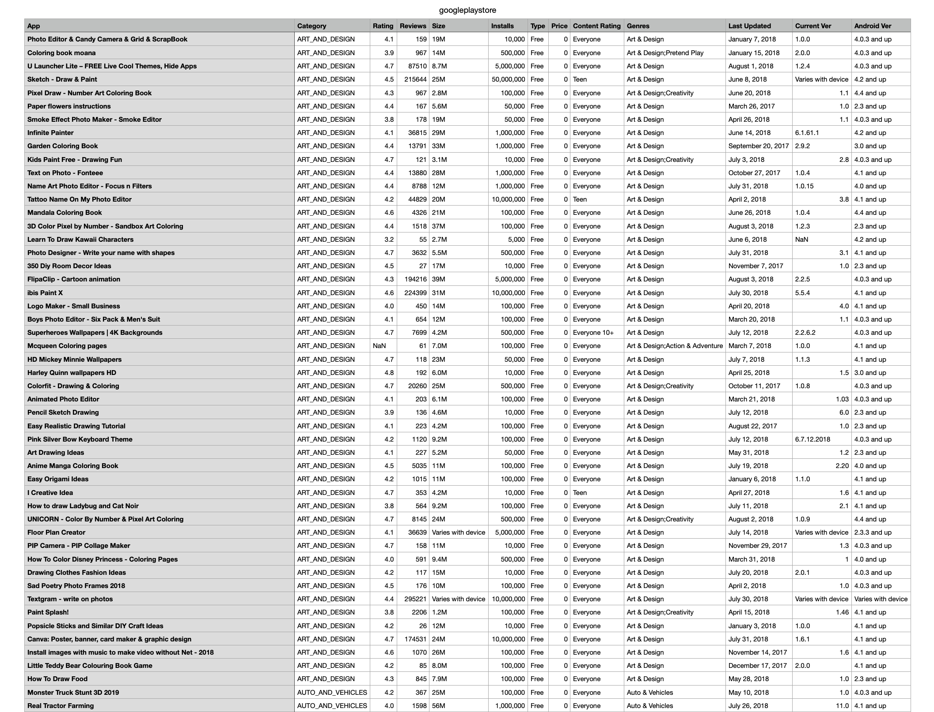
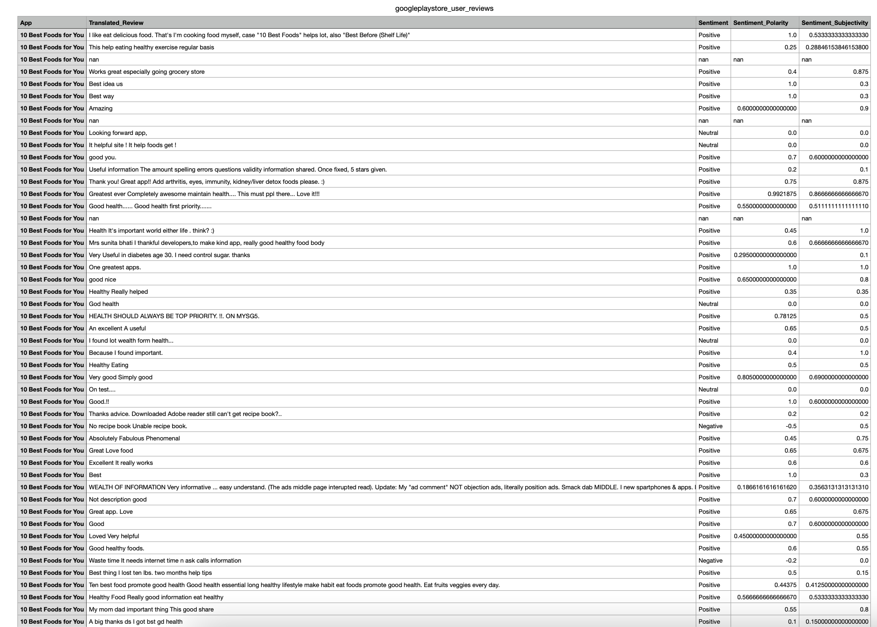
Data Statement
Notes:
Initially, we wanted to select a dataset that would help us extract sentiment data because we were aiming to create an ML model and provide recommendations. But the “Google Pkaggle.com that had 2 CSVs: “googleplaystore.csv” and “googleplaystore_user_reviews.csv”. The “googleplaystore_user_reviews.csv” already had the sentiment data extracted through web scraping.

Slide 5
Methodology
Remove duplicates
Handle missing values Standardized formats
Correlation of price, rating, and sentiment with user engagement and downloads
Data preparation
Advanced Analysis
EDA Analysis
Summarize
Trends in app numbers over time
Content ratings distribution
App categories analysis
Provide a well-rounded view of the factors contributing to app success on the Google Play Store

Slide 6
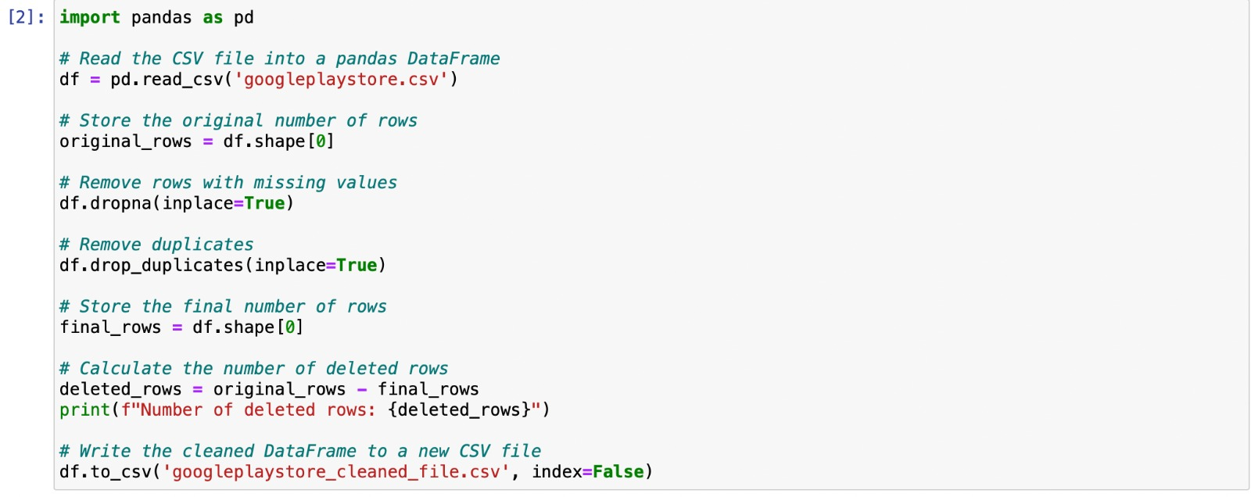
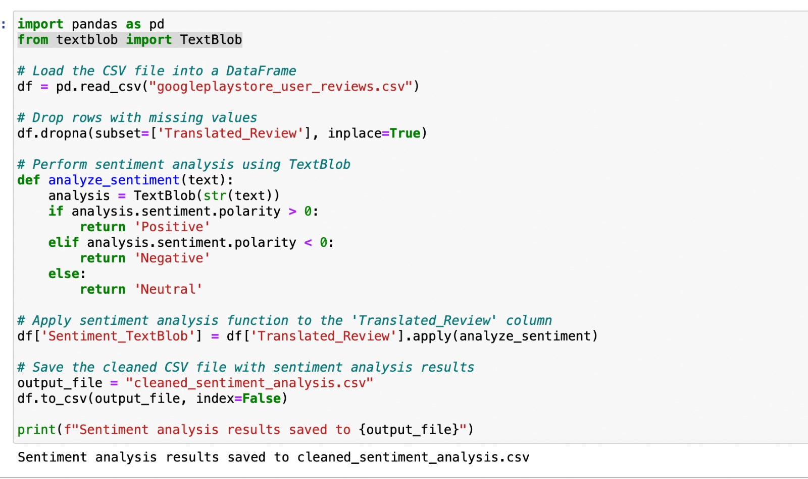
Data Preparation: Pre-Processing

Slide 7
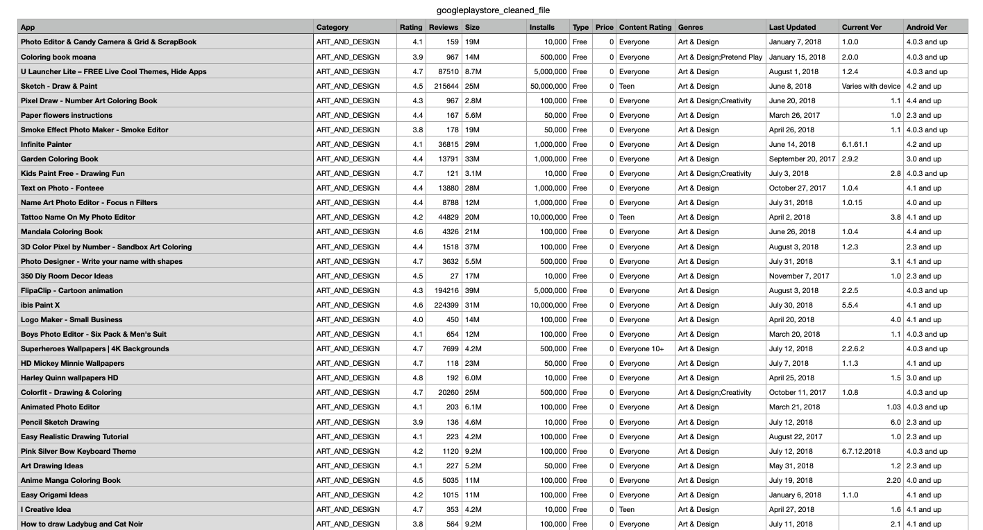
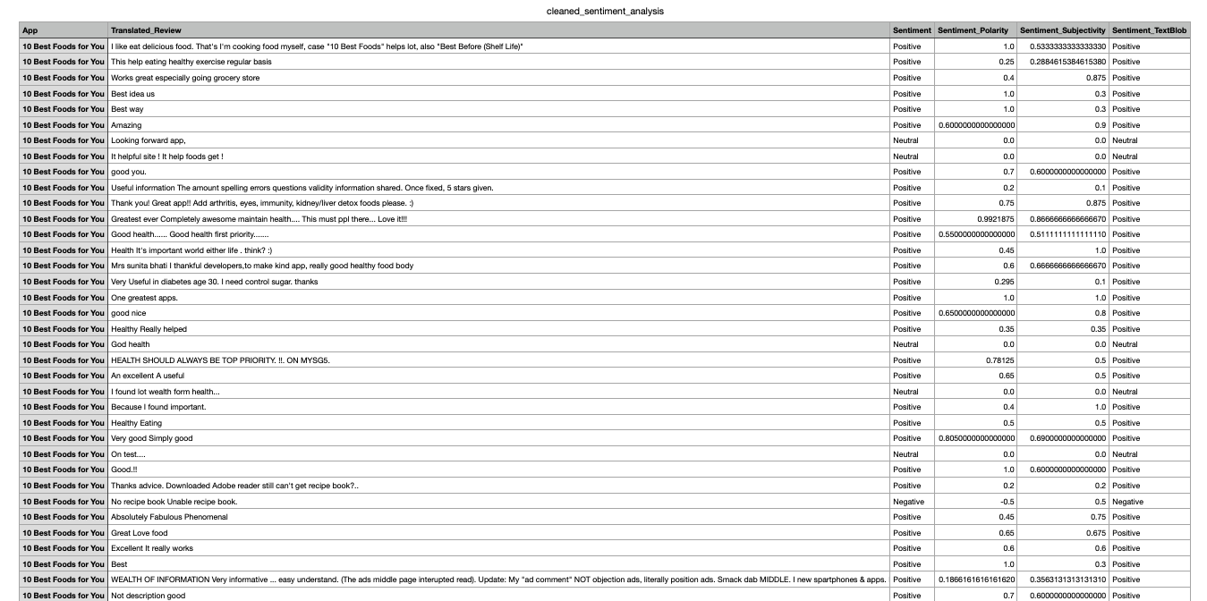
Cleaned Data

Slide 8
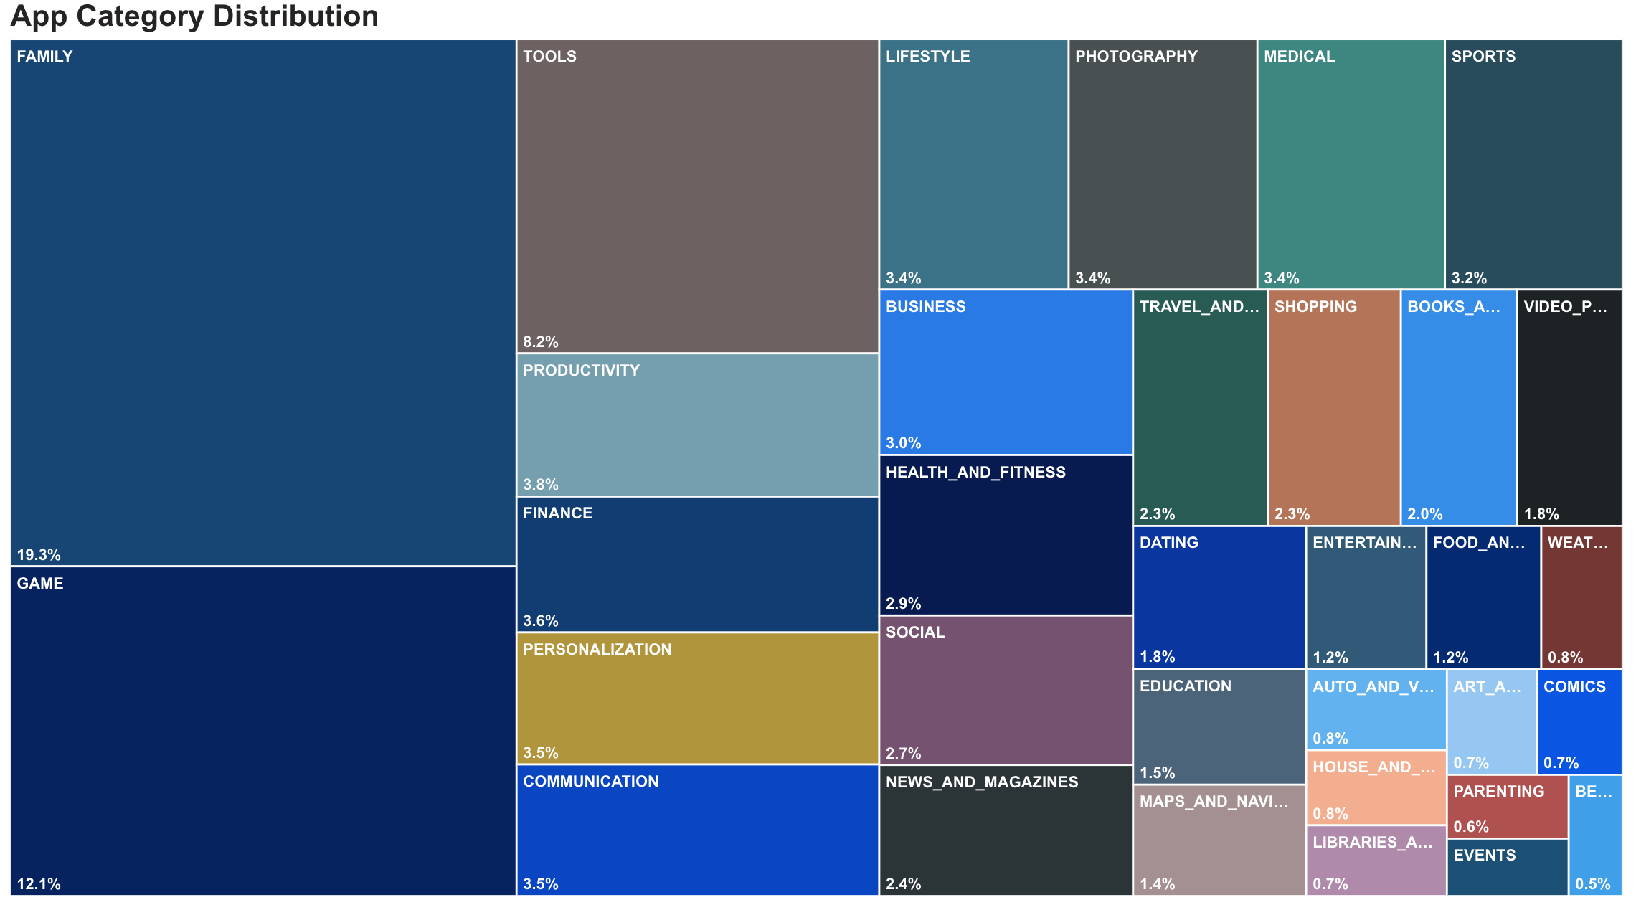
App categories in Google Play Store
Notes:
High Competition: Family and game categories are saturated
Growth Opportunities: Less saturated categories like photography and shopping offer entry points.

Slide 9
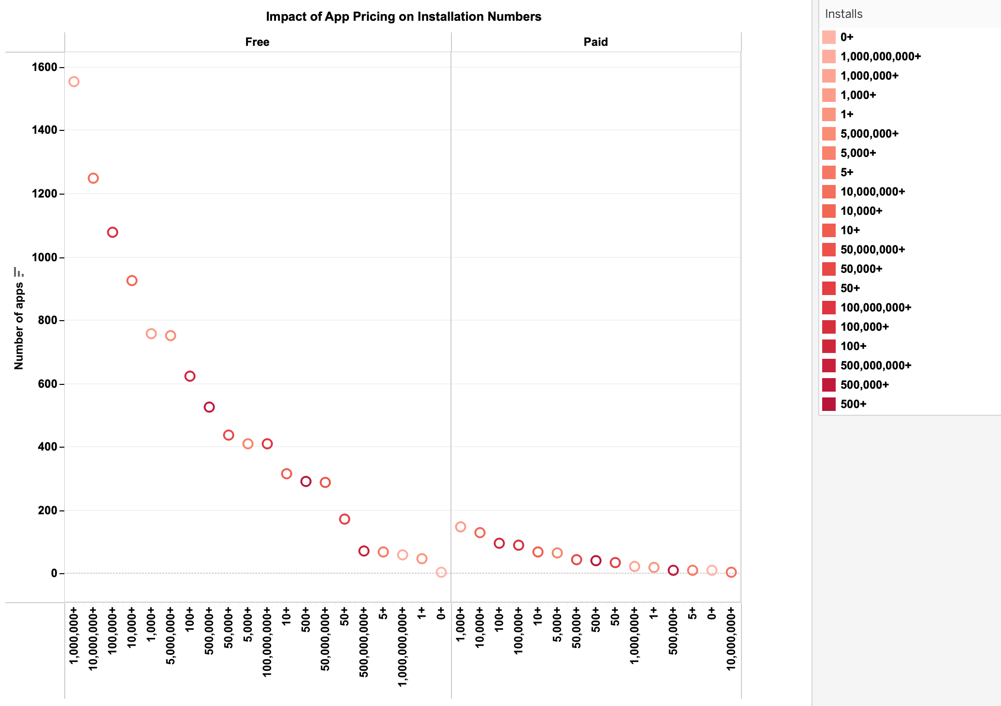
Analysis of App Download Trends by Price Category
Notes:
Free apps dominate the download charts, with the number of free apps increasing along with the number of installs. Paid apps, on the other hand, are most common in the $1 to $100 price range, but see far fewer downloads overall. This suggests that users are more likely to download free apps, possibly because they are more willing to try something they don't have to pay for upfront.

Slide 10
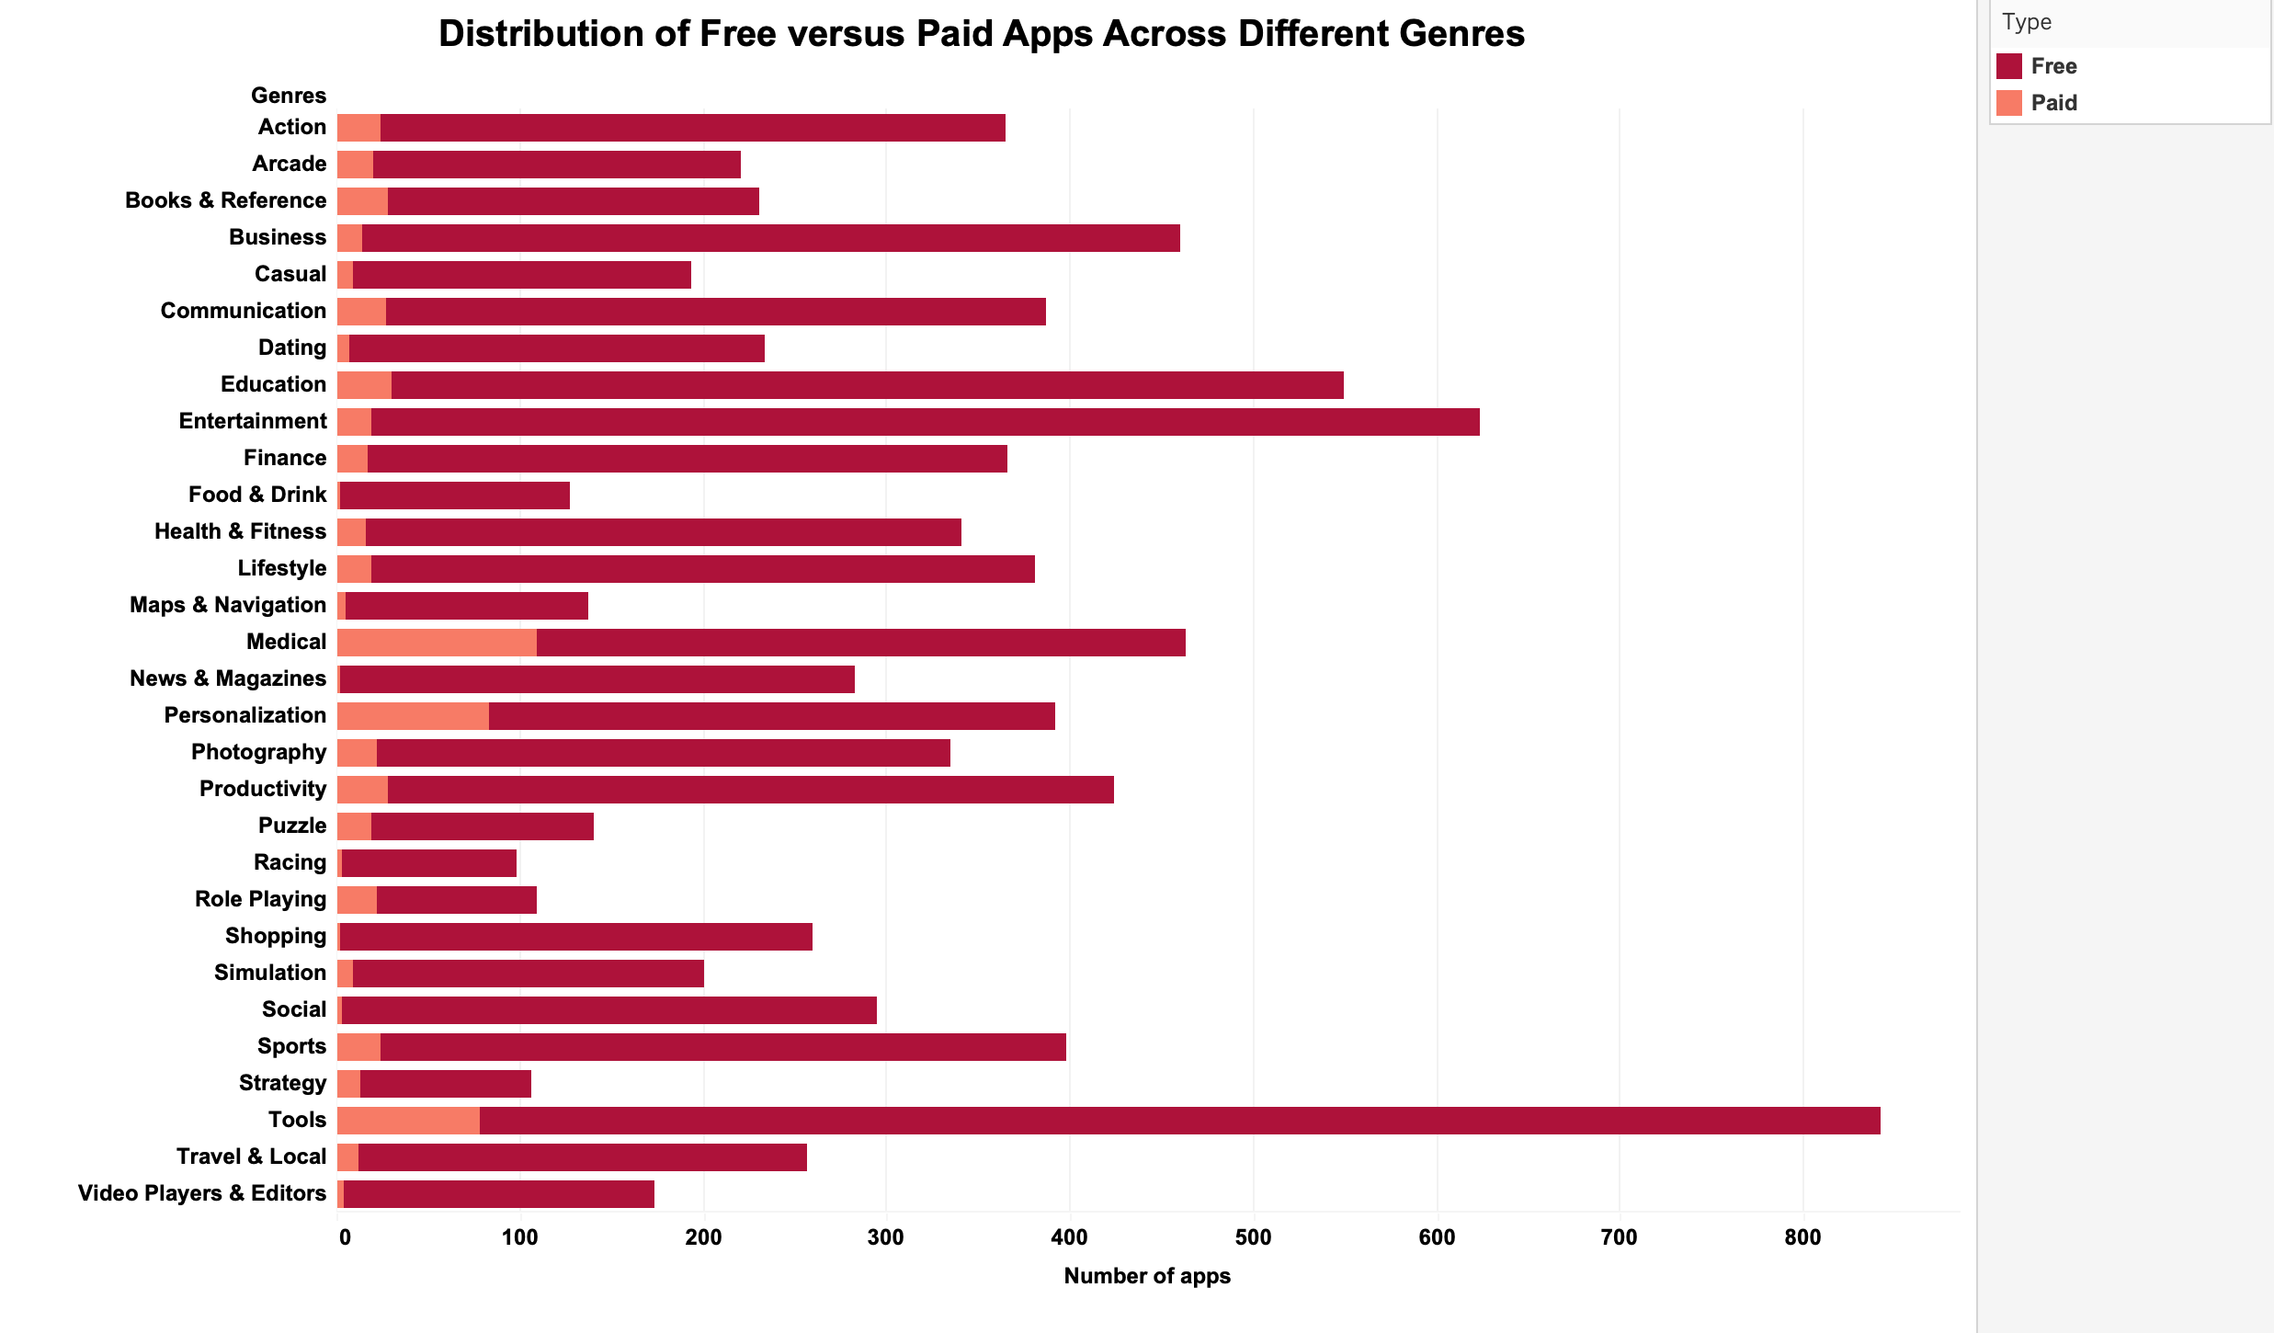
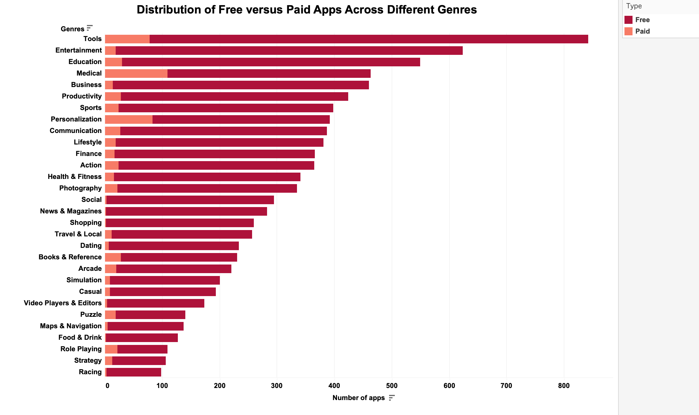
Comparative Overview of App Distribution: Free vs. Paid by Genre
Notes:
Free apps rule the app store! No matter the category, from Games to Education, free apps vastly outnumber their paid counterparts. Imagine a genre like Action with over 300 free apps compared to a mere 20 paid ones! This trend holds true across the board, suggesting that developers favor offering free apps, while users seem more inclined towards downloading them.

Slide 11
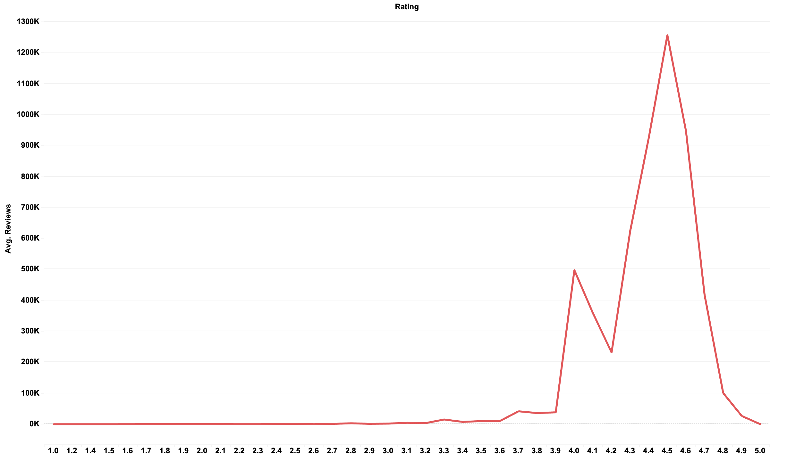
App Rating Distribution Based on Volume of Reviews
Notes:
The chart paints a fascinating picture of app store ratings! It reveals a bias towards positive reviews. Imagine a bell curve, but slightly lopsided. The peak sits around 4 stars, indicating that most apps receive a "good" rating. There's a gradual decline towards both ends of the scale, but interestingly, the decline is steeper for negative ratings (below 4 stars) compared to positive ones (above 4 stars). This suggests two things: first, users are generally more satisfied with apps than dissatisfied, and second, negative experiences might be more likely to motivate users to leave a review.

Slide 12
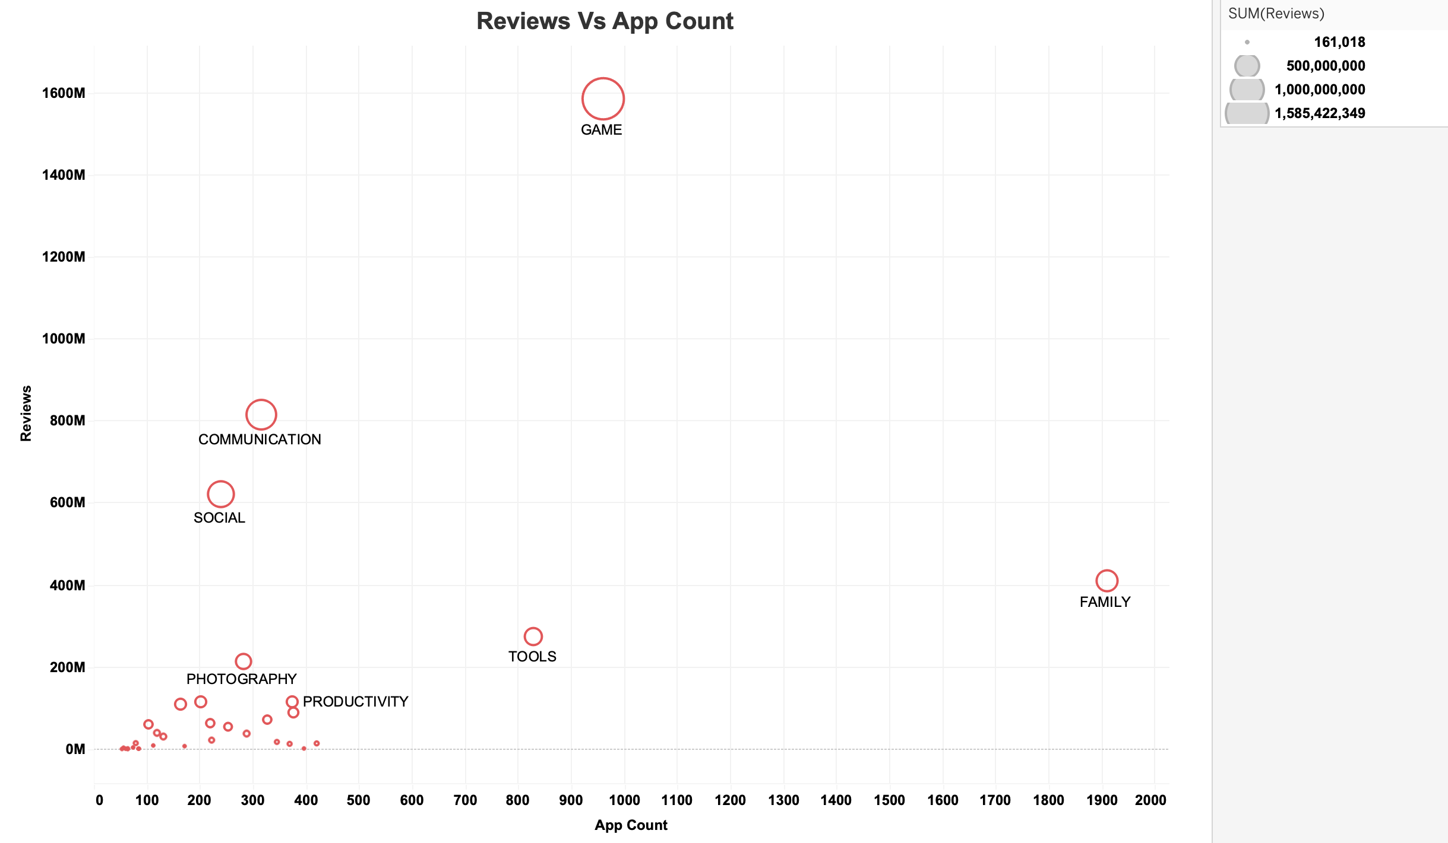
Correlation Between User Reviews and App Volume by Category
Notes:
The chart shows how popular apps are based on user reviews. It looks at two things: the number of reviews an app has and what category the app belongs to. There are many more apps with few reviews than apps with tons of reviews. Most categories have a similar pattern: many quiet apps and a few very popular ones with tons of reviews. Most apps get barely a peep – just a handful of reviews. Even popular categories like Games have mostly quiet apps, with only a few games generating a big buzz (lots of reviews). So, just like whispers in a crowded room, most apps struggle to be heard by users.

Slide 13
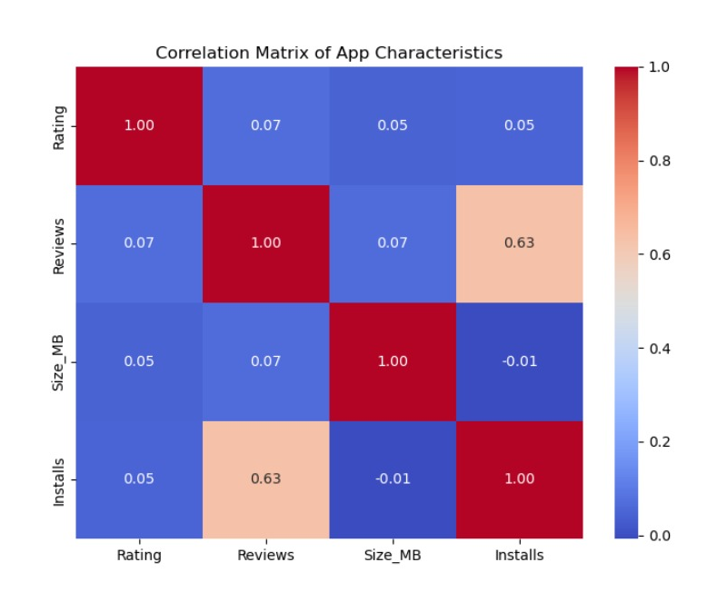
Correlation Matrix of App Characteristics
Notes:
Understanding the association and strength between characteristics:
The strongest positive correlation observed is between Reviews and Installs (0.63), indicating that apps with more reviews tend to have more installations. The weakest correlation is between Size_MB and Installs (-0.01), suggesting that the size of the app has little to no relationship with the number of installations.

Slide 14
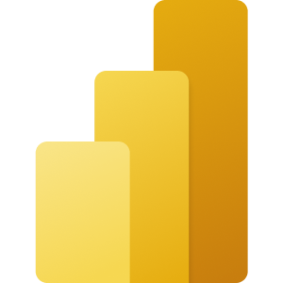

Microsoft Power BI
Google User Reviews
Notes:
This dashboard provides an analysis of sentiment polarity and reviews for different apps. The main components are:
Word Cloud: The word cloud visualizes the most frequently used words in the translated reviews, giving insights into common themes or topics discussed by users.
Sentiment Polarity Distribution: The pie chart shows the distribution of sentiment polarity (positive, negative, and neutral) across all reviews. The majority of reviews (64.11%) are neutral, while 22.1% are positive, and 13.79% are negative.
Sum of Sentiment Polarity by App: The bar chart displays the sum of sentiment polarity scores for each app. This allows for comparison of overall sentiment across different apps, with higher bars indicating more positive sentiment and lower bars indicating more negative sentiment.
The dashboard provides a comprehensive view of user reviews and sentiment analysis for various apps. The word cloud highlights common review themes, the pie chart summarizes the overall sentiment distribution, and the bar chart enables a comparison of sentiment scores across individual apps.
By combining these visualizations, the dashboard offers insights into user feedback, sentiment trends, and potential areas of improvement or focus for app development and user experience enhancement.

Slide 15
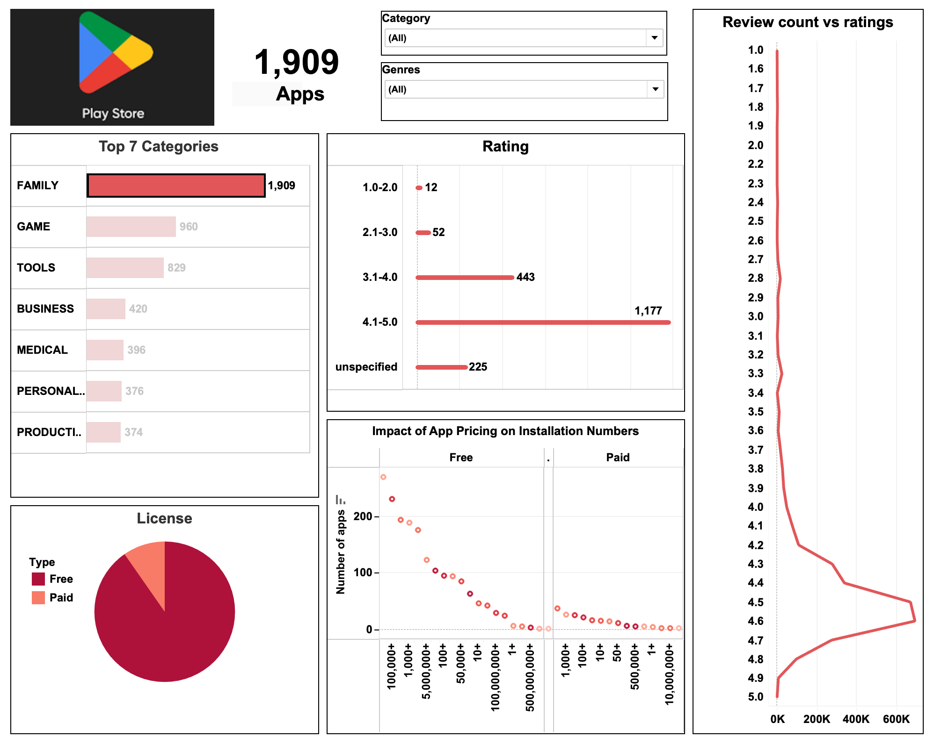
Play Store App Ecosystem Analysis Dashboard
Notes:
1. App Pricing vs Installs:
This chart likely shows a comparison between the price of an app and the number of times it's been downloaded.
It might reveal that free apps are downloaded significantly more than paid apps.
Users are likely more willing to try free apps before committing to a purchase.
2. Free vs Paid Apps by Genre:
This chart might illustrate the distribution of free and paid apps across different app store categories (Games, Education, etc.).
It would likely show a dominance of free apps across all genres compared to paid apps.
3. Average Rating Distribution:
This chart depicts the average app rating on a five-star scale.
It might show a bias towards positive ratings, with a peak around 4 stars.
There are likely fewer negative ratings compared to positive ones, suggesting users are more inclined to review apps they enjoyed.
4. Reviews vs App Count:
This chart explores the popularity of apps based on user reviews.
It might reveal a pyramid-like structure with many apps having very few reviews and a select few accumulating a large number of reviews (especially popular games).
Most apps struggle to generate significant user buzz.
Overall Insights:
Free apps seem to be the dominant force in terms of downloads across categories.
Users are generally more likely to leave positive reviews than negative ones.
A vast majority of apps receive very few reviews, indicating they struggle to gain user traction.
Only a small percentage of apps, particularly in popular categories like Games, achieve high review volumes.

Slide 16
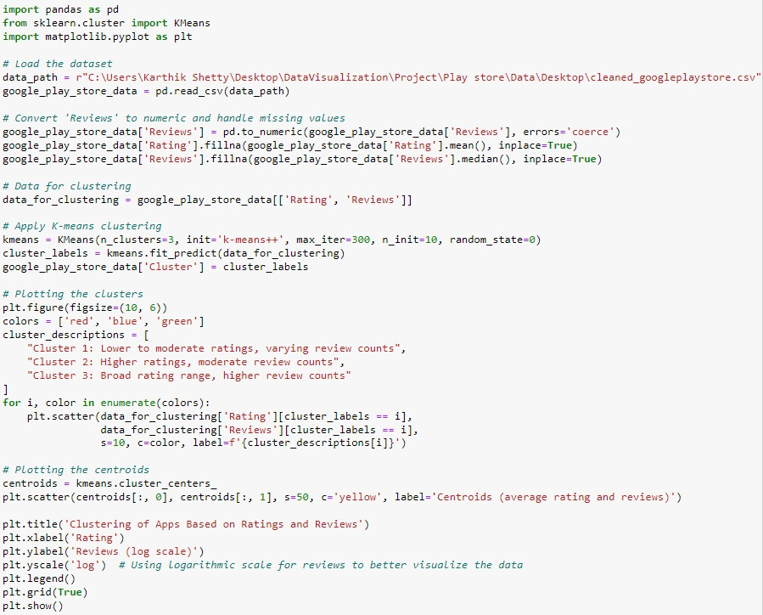
The Ultimate Question: What kind of Apps do well in the Google Play Store market?

Slide 17
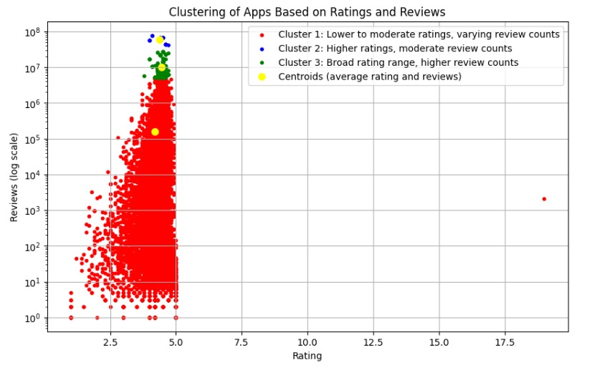
The Answer:
Notes:
This graph illustrates the outcome of the K-means clustering that we applied to the Google Play Store data and it focuses on two primary features: ratings and the number of reviews received. Let’s breakdown the graph! The red cluster encompasses apps with lower to moderate ratings and a wide variation in review counts, possibly indicating less popular or niche apps or newly introduced ones that are yet to garner significant traction. The blue cluster comprises apps with higher ratings and moderate review counts, suggesting well-received apps that may not have achieved widespread popularity. The green cluster includes apps with diverse ratings but consistently high review counts, likely indicating highly engaging or popular apps that generate substantial user interaction regardless of satisfaction levels. Each cluster's centroid, represented by yellow points, signifies the average rating and review count for apps within that cluster, aiding in identifying typical cluster characteristics.

Slide 18
Recommendations from App Market Analysis
To App Developers - Strategies for Optimizing App Performance:
Targeting the Green Cluster (Cluster 3):
Focus on maintaining high user engagement and positive reviews.
Regularly update content and introduce new features to sustain popularity.
Improving Apps in the Red Cluster (Cluster 1):
Address user feedback and enhance app quality to increase ratings.
Resolve issues identified through user engagement metrics.
Strategizing for Apps in the Blue Cluster (Cluster 2):
Increase app visibility through targeted marketing campaigns.
Optimize app store listings to improve discoverability and user reception.
Utilizing Centroids for Insight:
Leverage average rating and review count insights to understand user preferences.
Tailor app development and marketing strategies based on cluster characteristics.
Notes:
Targeting the Green Cluster (Cluster 3): Apps within the green cluster exhibit a wide range of ratings but consistently high numbers of reviews, indicating high user engagement and popularity. Developers should continue to nurture these apps by focusing on maintaining and enhancing their appeal to users. This may involve regularly updating content, introducing new features, and actively engaging with the user community to sustain high levels of user interaction and positive reviews.
Improving Apps in the Red Cluster (Cluster 1): Apps in the red cluster tend to have lower to moderate ratings and varying numbers of reviews, suggesting areas for improvement in user satisfaction and app quality. Developers should prioritize addressing user feedback and addressing any issues or deficiencies identified through reviews and user engagement metrics. By enhancing the user experience and addressing pain points, developers can work towards moving these apps towards higher-rated clusters, thereby increasing their visibility and appeal to users.
Strategizing for Apps in the Blue Cluster (Cluster 2): Apps in the blue cluster typically have higher ratings and moderate review counts, indicating positive user reception but perhaps not yet achieving widespread popularity. Developers should focus on strategies to increase the visibility and reach of these apps, such as targeted marketing campaigns, partnerships with influencers or other app developers, and optimizing app store listings to improve discoverability. Additionally, developers should continue to monitor user feedback and iterate on app features to maintain and further improve user satisfaction.
Utilizing Centroids for Insight: The centroids of each cluster represent the average rating and review count for apps within that cluster, providing valuable insights into the typical characteristics of apps in each group. Developers can leverage this information to better understand user preferences and tailor their app development and marketing strategies accordingly. For example, apps targeting the green cluster may prioritize features that drive high user engagement, while apps in the red cluster may focus on addressing specific pain points identified through user feedback.
Overall, by leveraging the insights gained from the cluster analysis, app developers and platform owners can make informed decisions to optimize app performance, enhance user satisfaction, and drive growth and success on the Google Play Store.

Slide 19
Recommendations from App Market Analysis
Revenue-Generating Strategies for the Google Play Store:
Featured Placements: Offer premium visibility options for apps in high-engagement clusters.
Premium Recommendations:
Implement a system recommending high-rated apps for a referral fee.
In-App Advertising:
Provide targeted advertising opportunities based on user behavior.
Subscription Referral Program:
Earn a share of subscription revenues from referred apps.
Data Insights Services:
Offer developers insights into user behavior for informed decision- making.
Premium Analytics Dashboard:
Provide advanced analytics tools for developers with a subscription fee.
Notes:
Based on the cluster analysis of apps on the Google Play Store, there are several recommendations for the Play Store itself to generate revenue:
Featured Placement Fees: Offer app developers the option to pay for featured placements within the Play Store for apps falling within the green cluster (Cluster 3). Given the high user engagement and popularity of these apps, developers may be willing to pay a premium for increased visibility on the Play Store's homepage, category pages, or search results.
Premium App Recommendations: Implement a recommendation system that suggests premium apps from the blue cluster (Cluster 2) to users based on their preferences and usage patterns. The Play Store could charge a referral fee or commission for each premium app purchase made through these recommendations, providing an additional revenue stream.
In-App Advertising: Offer advertising opportunities within apps across all clusters, allowing advertisers to target users based on their app usage behavior and preferences. Apps within the green cluster (Cluster 3), with their high user engagement and interaction rates, may attract advertisers willing to pay higher advertising rates for increased exposure to a highly engaged audience.
Subscription Referral Program: Introduce a subscription referral program where the Play Store receives a percentage of subscription revenues generated from apps within the red cluster (Cluster 1) that are referred to users. By promoting these apps to users who may be interested in improving their user experience, the Play Store can earn a share of the subscription revenue generated by these apps.
Data Insights and Analytics Services: Offer data insights and analytics services to app developers, providing them with valuable insights into user behavior, preferences, and market trends based on the cluster analysis data. Developers may be willing to pay for access to these insights to inform their app development, marketing, and monetization strategies.
Premium Analytics Dashboard: Introduce a premium analytics dashboard for app developers, offering advanced analytics and visualization tools to help them better understand and optimize their app performance. The Play Store could charge a subscription fee for access to these premium features, providing developers with valuable tools to improve their app's success on the platform.
By implementing these revenue-generating strategies, the Google Play Store can leverage the insights gained from the cluster analysis to maximize revenue opportunities while providing value to both users and app developers on the platform.

Slide 20
Thank You!

